Slide 1
Lecture 10 - Review
(encapsulation; inheritance; polymorphism)
Programming
Principles and Practice Using C++
Shengfa Wang

Slide 2
OOP
(Abstraction) : Data abstraction is a programming (and design) technique that relies on the separation of interface and implementation.
OOP Character
1
2
3
Encapsulation：
Data encapsulation is the most striking feature of a class.
Data hiding or information hiding.
Inheritance:
Subclasses can inherit instance variables and member functions of its superclasses.
Used by programmers to reduce programming time.
Polymorphism:
Some code or operations behave differently in different contexts.
Such as :
function overloading, operator overloading function overriding
Notes:
封装：一是把对象的全部属性和行为结合在一起，形成一个不可分割的独立单位；二是尽可能隐蔽对象的内部属性和实现细节，对外形成一道屏障，与外部的联系只能通过公共接口实现。
继承：子类自动共享父类数据和方法的机制，它由类的派生体现。一个子类直接继承父类的全部描述，同时可修改和扩充，继承是对父类的重用机制。
多态性：是在继承体系结构中，同一消息为不同的对象接受时可产生完全不同的行动。利用多态性用户可发送一个通用的信息，而将所有的实现细节都留给接受消息的对象自行决定。

Slide 3
Basic topics
Namespace、scope 、static (data member or function member)
Reference、pointer
Class: access、date member、function member
  constructor/ destructor
    Parameterized constructors
    Constructors with default argument
    Overloaded constructors (Function/operator Overloading)
    Copy constructors (new-Shallow vs. Deep Copying)
    Destructor(delete)
  this Pointer
  friend (function/class)
overloading/overriding/hiding
Inheritance (single)
Template(function/class)

Slide 4

Namespace、scope
using namespace std;
scope
在一个源文件中定义的全局变量的作用域为：
a.本程序的全部范围
b.本函数的全部范围
c.从定义该变量的位置开始到本文件结束
d.以上说法都不正确

Slide 5
Test
what error? How to correct?
//This is buggy code
char *strA()
{
char str[] = “Hello world”;
return str;
}
Notes:
Steal from 郭浩’s C++程序设计
str[] = "hello world"//"hello world"常量字符串在内存中有两份拷贝，一份在动态分配的栈中，一份在静态存储区，str[]数组为函数内部局部变量，存储在栈上，在strA()函数退出时，栈要清空，局部变量的内存也被清空

Slide 6
Test
char str[] = “Hello world”;
char *strA()
{
char *str = “Hello world”;
return str;
}
// or
char *strA()
{
static char str[] = “Hello world”;
return str;
}
Notes:
Steal from 郭浩’s C++程序设计
char *str = "hello world"//一份拷贝，"hello world"是常量字符串存在静态数据区，把该字符串常量存在的静态数据区的首地址赋给指针str，所以strA()函数退出时，该字符串常量所在内存不会被回收，故能通过指针访问；

Slide 7
Static
#include <iostream>
using namespace std;
class SavingsAccount{
private:
double savingsBalance; //current saving balance
static double annualInterestRate;// annual Interest Rate
public:
SavingsAccount(double m); //constructor
SavingsAccount(SavingsAccount& s); //copy constructor
void calculateMonthlyInterest(); //monthly interest
static void modifyInterestRate(double new_Rate); //set interest rate
void print();//show the balance
~SavingsAccount();//destructor
};
double SavingsAccount::annualInterestRate = 0.03;
SavingsAccount::SavingsAccount(double m):savingsBalance(m){
cout <<"construct SavingsAccount" << endl;
}

Slide 8
Static
SavingsAccount::SavingsAccount(SavingsAccount& s) {
savingsBalance = s.savingsBalance;
cout << "copy construct SavingsAccount" << endl;
}
void SavingsAccount::calculateMonthlyInterest(){
savingsBalance +=savingsBalance*annualInterestRate/12;
}
void SavingsAccount::modifyInterestRate(double new_Rate) {
annualInterestRate = new_Rate;
}
void SavingsAccount::print() {
cout << this->savingsBalance << endl;
}
SavingsAccount::~SavingsAccount() {
cout << "delete a savingsAccount" << endl;
}
void display(SavingsAccount s) {
s.calculateMonthlyInterest();
s.print();
}
void main(){
SavingsAccount s1(2000.0);
s1.modifyInterestRate(0.06);
SavingsAccount s2(4000.0);
…
}
Notes:
静态数据成员要在程序一开始运行时就必须存在。因为函数在程序运行中被调用，所以静态数据成员不能在任何函数内分配空间和初始化。

Slide 9
Summary
出现在类体外的函数定义不能指定关键字static；
静态成员之间可以相互访问，包括静态成员函数访问静态数据成员和访问静态成员函数；
非静态成员函数可以任意地访问静态成员函数和静态数据成员；
静态成员函数不能访问非静态成员函数和非静态数据成员；
静态数据成员需要在类体外初始化；
静态成员函数没有this pointer;

Slide 10
Static Const
class Test
{
public:
Test():a(0){}
enum {size1=100,size2=200};
private:
const int a;//只能在构造函数初始化列表中初始化
static int b;//在类的实现文件中定义并初始化
const static int c;//与 static const int c;相同。
};
int Test::b=0;//static成员变量不能在构造函数初始化列表中初始化，因为它不属于某个对象
cosnt int Test::c=0;//注意：给静态成员变量赋值时，不需要加static修饰符。但要加cosnt

Slide 11
Test
class MyClass{
public:
void functionl(MyClass &c) {cout << c.data;}
static void function2() {cout << data;}
static void function3(MyClass &c) {cout << c.data;}
void function4() {cout << data;}
private:
int data;
};
Which is wrong?
A)function1 B)function2
C)function3 D)function4

Slide 12

Reference/pointer
Test
void swap1(int p, int q)
{
int tmp;
tmp = p;
p = q;
q = tmp;
}
void swap2(int *p, int *q)
{
int *tmp;
tmp = p;
*p = *q;
*q = *tmp;
}
void swap3(int *p, int *q)
{
int *tmp;
tmp = p;
p = q;
q = tmp;
}
void swap4(int *p, int *q)
{
int tmp;
tmp = *p;
*p = *q;
*q = tmp;
}
void swap5(int &p, int &q)
{
int tmp;
tmp = p;
p = q;
q = tmp;
}
Notes:
Steal from 郭浩’s C++程序设计

Slide 13
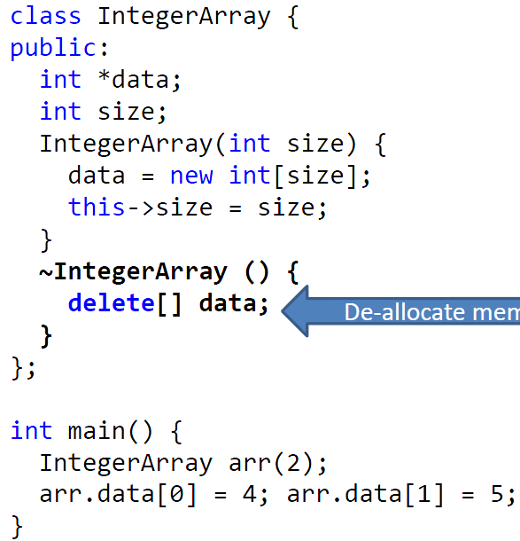
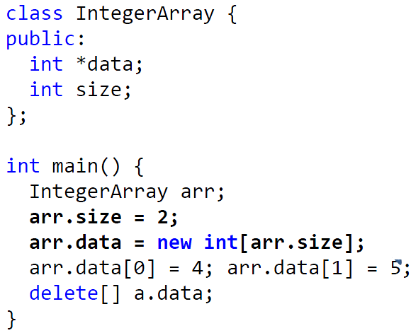
Encapsulation
Representing an Array of Integers

Slide 14
The this Pointer
Use only in non-static member function
such as, copy assignment, return *this
The same name parameters
such as, void setName(string name) { this->name=name; }
It points to the object for which the member function is called
The this pointer is used directly

Slide 15
Destructor
Only one destructor
Default (parameter less)
Destroy object, delete/ delete[]

Slide 16
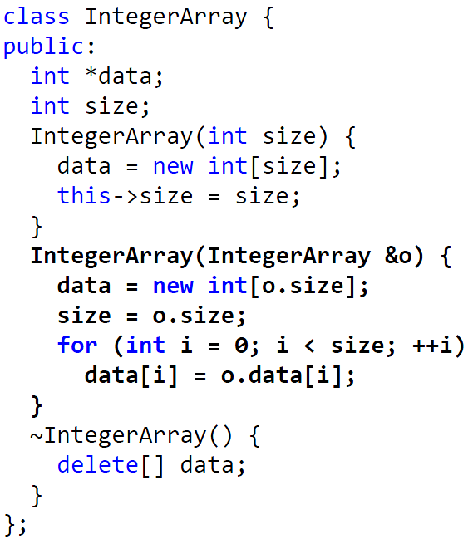
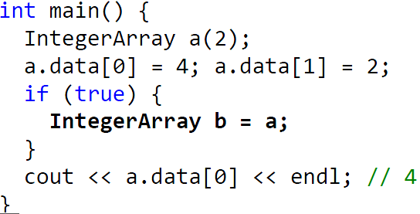
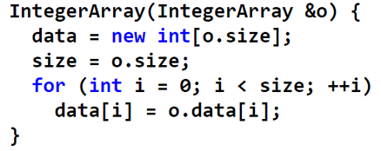
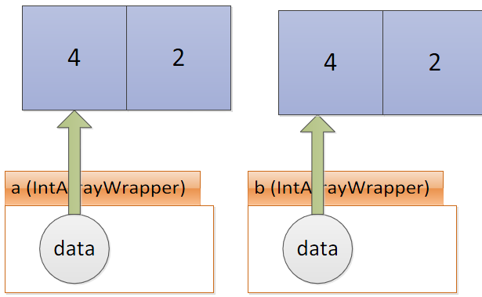

Copy Constructor
?

Slide 17
Copy Assignment
& (const IntegerArray & o)
IntegerArray ________ operator = _______________
{
if (___________ )
{
if (name!= NULL)
{______________ }
this->id = str.id;
int len = strlen(str.name);
__________________________
strcpy_s(name, strlen(str.name) + 1, str.name);
}
return *this;
}
this != & o
delete [] name;
name = new char[len + 1];

Slide 18
Function Overloading
Rules
  Differ either by the parameter number, data types, or the order.
  The same function name is used for various instances of function call.
Constructor overloading
Function overloading
#include <iostream>
using namespace std;
void print(int i) { cout << " Here is int " << i << endl; }
void print(double f) { cout << " Here is float " << f << endl; }
void print(char* c) { cout << " Here is char* " << c << endl; }
int main()
{
print(10);
print(10.10);
print("ten");
}

Slide 19
Operator Overloading
#include<iostream>
using namespace std;
class Calculator
{
public:
Calculator() { }
Calculator& operator ++ () ;
Calculator operator ++ (int) ;
int operator() () ;
private:
unsigned int value;
};
Calculator& Calculator::operator ++ ()
{
value ++ ;
return *this;
}
Calculator Calculator::operator ++ (int)
{
Calculator temp=*this;
value ++ ;
return temp;
}
int Calculator::operator() ()
{
return value ;
}
void main()
{
Calculator Counter ;
cout<< Counter();
++++Counter;
cout<< Counter();
Calculator C1=Counter++;
cout<< C1();
cout<< Counter();
}
value=0;

Slide 20
overloading assignment operator=?
MyStr(const MyStr& str){
cout << "copy constructor" << endl;
id = str.id;
name = new char[strlen(str.name) + 1];
strcpy_s(name, strlen(str.name) + 1, str.name);
}
MyStr& operator =(const MyStr& str) {//赋值运算符
cout << "operator =" << endl;
if (this != &str) {
if (name!= NULL)
delete [] name;
this->id = str.id;
int len = strlen(str.name);
name = new char[len + 1];
strcpy_s(name, strlen(str.name) + 1, str.name);
}
return *this;
}
~MyStr(){delete [] name; }
};
int main(){
MyStr str1(1, "hhxx");
cout << "====================" << endl;
MyStr str2;
str2 = str1;
cout << "====================" << endl;
MyStr str3 = str2;
return 0;
}
#include<iostream>
#include<string>
using namespace std;
class MyStr
{
char *name;
int id;
public:
MyStr() {
name=NULL;// is necessary
cout << "default constructor" << endl;
}
MyStr(int _id, char *_name) { //constructor
cout << "constructor" << endl;
if (name!= NULL)
id = _id;
name = new char[strlen(_name) + 1];
strcpy_s(name, strlen(_name) + 1, _name);
}
Notes:
http://www.tuicool.com/articles/zaQrYvR

Slide 21
Operator Overloading
ostream & operator <<(ostream & os, const ClassType &object){}
istream & operator>>(istream & is, ClassType &object){}
Classname & operator=( const classname & object){}//copy assigment
other operators
  Overloading the arithmetic operators (+ - * /)
  Overloading comparison operators (< > =< >= !=)
  Overloading unary operators +, -, and !
  Overloading the increment and decrement operators (++ -- Prefix and postfix )
  Overloading the subscript operators []
Overloading operators using member functions , friend, &

Slide 22
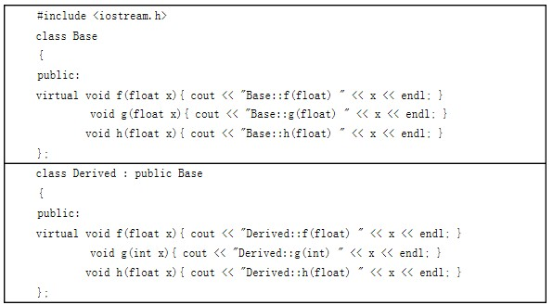
Overriding
（1）function Derived::f(float) override Base::f(float)
（2） function Derived::g(int) hide Base::g(float), not the overloading
（3） function Derived::h(float) hide Base::h(float), not the overriding

Slide 23
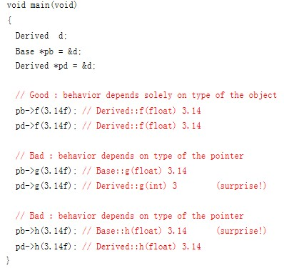
Overriding
Add virtual !

Slide 24
Overloading, Overriding and Hiding
成员函数被重载的特征：
（1）相同的范围（在同一个类中）；
（2）函数名字相同；
（3）参数不同；
（4）virtual关键字可有可无
覆盖是指派生类函数覆盖基类函数，特征是：
（1）不同的范围（分别位于派生类与基类）；
（2）函数名字相同；
（3）参数相同；
（4）基类函数必须有virtual关键字。
“隐藏”是指派生类的函数屏蔽了与其同名的基类函数，规则如下
（1）如果派生类的函数与基类的函数同名，但是参数不同。此时，不论有无virtual关键字，基类的函数将被隐藏（注意别与重载混淆）。
（2）如果派生类的函数与基类的函数同名，并且参数也相同，但是基类函数没有virtual 关键字。此时，基类的函数被隐藏（注意别与覆盖混淆）

Slide 25
Overriding
#include<iostream>
using namespace std;
class A {
virtual float area() const=0;
};
class B:public A{
B(float a1,float a2):x(a1),y(a2){}
float area() const {return(x*y);}
protected:
float x,y;
};
class C:public A{
C(float a3,float a4):x1(a3),y1(a4){}
float area() const {return(0.5*x1*y1);}
protected:
float x1,y1;
};
void main()
{
B b1(5.6,8);
C c1(5,6);
A *p[2]={&b1,&c1};
for(int i=0;i<2;i++)
{
cout<<p[i]->area()<<endl;
}
}
Output: 44.8
15

Slide 26
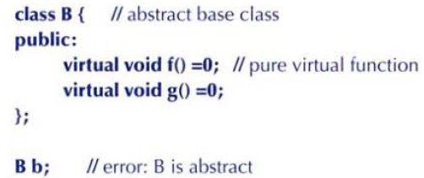
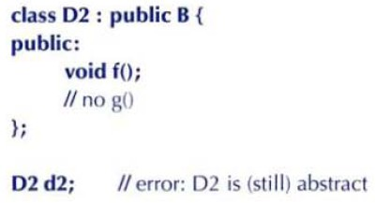

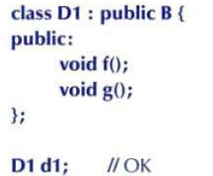
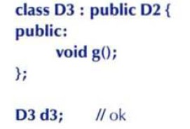
Pure virtual functions

Slide 27
Function Overloading
Test
#include<iostream.h>
void ff(int), ff(double);
void main( )
{
float a(88.18);
ff (a);
char b('a');
ff (b);
}
void ff(double x)
{ cout<<"ff(double):"<<x<<endl; }
void ff(int x)
{ cout<<"ff(int):"<<x<<endl; }
ff(double): 88.18
ff(int): 97

Slide 28
Function Overloading
Test
Given the following class definition, which of the following methods could be legally placed after the comment with the commented word "//Here"?
class Rid{
void amethod(int i, String s){}
//Here
};
1) void amethod(String s, int i){}
2) int amethod(int i, String s){}
3) void amethod(int i, String mystring){}
4) void Amethod(int i, String s) {}

Slide 29
Friend Function
#include <iostream>
using namespace std;
class Internet{
public:
Internet(const char *name , const char *address){
strcpy(Internet::name,name);
strcpy(Internet::address,address);
}
friend void ShowN(Internet &obj); //friend function declaration
private :
char name[20];
char address[20];
};
void ShowN(Internet &obj) { //definition,is not void Internet::ShowN(Internet &obj)
cout<<obj.name<<endl; //visit the data member of internet
}
void main(){
Internet a(“c++","www.cpluplu.com");
ShowN(a);
}
Notes:
通常对于普通函数来说,要访问类的保护成员是不可能的，如果想这么做那么必须把类的成员都生命成为public(共用的)，然而这做带来的问题遍是任何外部函数都可以毫无约束的访问它操作它，c++利用friend修饰符，可以让一些你设定的函数能够对这些保护数据进行操作，避免把类成员全部设置成public，最大限度的保护数据成员的安全。友元能够使得普通函数直接访问类的保护数据，避免了类成员函数的频繁调用，可以节约处理器开销，提高程序的效率，但所矛盾的是，即使是最大限度大保护，同样也破坏了类的封装特性，这即是友元的缺点，在现在cpu速度越来越快的今天我们并不推荐使用它，但它作为c++一个必要的知识点，一个完整的组成部分，我们还是需要讨论一下的。在类里声明一个普通数学，在前面加上friend修饰，那么这个函数就成了该类的友元，可以访问该类的一切成员。

Slide 30
Friend Function
#include <iostream>
using namespace std;
class Country;
class Internet{
public:
Internet(const char *name , const char *address){
strcpy(Internet::name,name);
strcpy(Internet::address,address);}
friend void ShowN(Internet &obj,Country &cn);//note here
public:
char name[20];
char address[20];
};
class Country{
public:
Country(){ strcpy(cname,“China"); }
friend void ShowN(Internet &obj,Country &cn);//note here
protected:
char cname[30];
};
void ShowN(Internet &obj,Country &cn){
cout<<cn.cname<<"|"<<obj.name<<endl;}
void main()
{
Internet a(“C++","www.cpluplu.com");
Country b;
ShowN(a,b);
}

Slide 31
friend Functions and friend Classes
friend function and friend classes
  Can access private and protected (more later) members of another class
  friend functions are not member functions of class
    Defined outside of class scope
Properties
  Friendship is granted, not taken
  NOT symmetric (if B a friend of A, A not necessarily a friend of B)
  NOT transitive (if A a friend of B, B a friend of C, A not necessarily a friend of C)

Slide 32
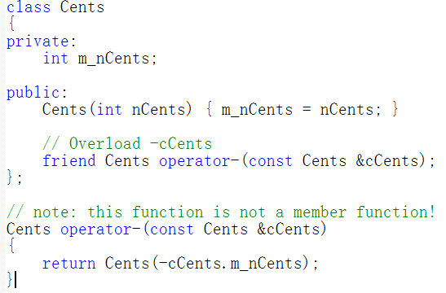
Overloading operators using friend functions
The negative operator is a unary operator that can be implemented using either method

Slide 33
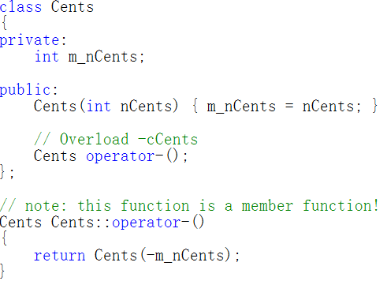
Overloading operators using member functions
Overload the same operator using a member function instead:
Remember that when C++ sees the function prototype Cents Cents::operator-();, the compiler internally converts this to Cents operator-(const Cents *this), which you will note is almost identical to our friend version Cents operator-(const Cents &cCents)!
a member function has an implicit *this pointer which always points to the class object the member function is working on. The parameter we had to list explicitly in the friend function version (which doesn’t have a *this pointer) becomes the implicit *this parameter in the member function version.1

Slide 34
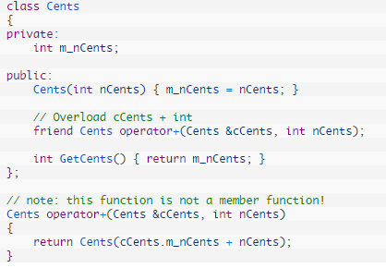
Overloading operators using friend functions
An example of a binary operator overloaded both ways

Slide 35
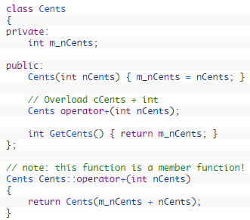
Overloading operators using member functions
Two-parameter friend function becomes a one-parameter member function, because the leftmost parameter (cCents) becomes the implicit *this parameter in the member function version.

Slide 36
Operator Overloading*
ostream & operator <<(ostream & os, const ClassType &object){}
istream & operator>>(istream & is, ClassType &object){}
Classname & operator=( const classname & object){}//copy assigment
other operators
  Overloading the arithmetic operators (+ - * /)
  Overloading comparison operators (< > =< >= !=)
  Overloading unary operators +, -, and !
  Overloading the increment and decrement operators (++ -- Prefix and postfix )
  Overloading the subscript operators []
Overloading operators using member functions , friend, &

Slide 37
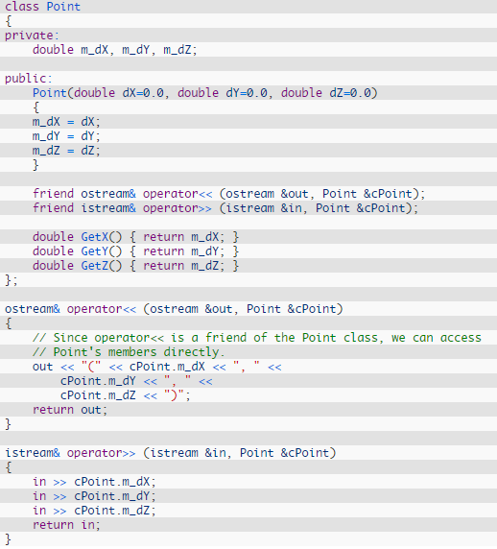
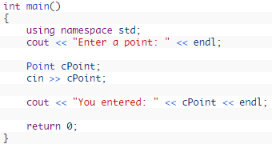

Slide 38
Private, Public and Protected
private:
声明的成员（无论数据成员或是成员函数）仅仅能被类的成员函数和友元访问。
public:
声明的成员（无论数据成员或是成员函数）能被任何人访问。
protected:
声明的成员（无论数据成员或是成员函数）仅仅能被类的成员函数，友元以及子类的成员函数和友元访问。

Slide 39
Private
#include<iostream>
using namespace std;
class A{
private:
char name;
void priFun() {cout<<“private! ";}
public:
A(char c) {name=c;}
void pubFun(A a1){
a1.priFun(); //？？！！
cout<<a1.name; //？？！！
}
};
void main(){
A a('a');
A b('b');
a.pubFun(b);
}

Slide 40
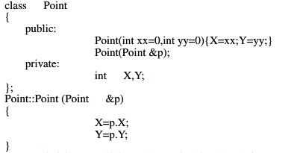
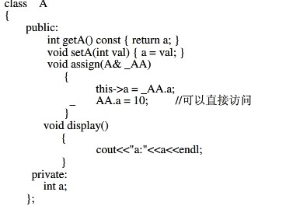
Private

Slide 41
Protected
class X {
public:
void setProtMemb( int i ) { m_protMemb = i; }
void Display() { cout << m_protMemb << endl; }
protected:
int m_protMemb;
void Protfunc() { cout << "\nAccess allowed\n"; }
} x;
class Y : public X {
public: void useProtfunc() { Protfunc(); } } y;
int main() {
x.m_protMemb;
x.setProtMemb( 0 );
x.Display();
y.setProtMemb( 5 );
y.Protfunc();
y.useProtfunc();
}
//error, m_protMemb is protected
// OK, uses public access function
// OK, uses public access function y.Display();
//error, Protfunc() is protected
// OK, uses public access function // in derived class

Slide 42
Inheritance
Public inheritance
class B : public A
Base class
Derived class
private
protected protected
public public
private
protected
public

Slide 43
Private Inheritance
class B : Private A
Private inheritance
Base class
Derived class
private
protected
private
public
private
private
protected
public

Slide 44
Protected Inheritance
class B : Protected A
Protected inheritance
Base class
Derived class
private
protected
protected
public
protected
private
protected
public

Slide 45
Inheritance
class A
private
class B:public A
class C:private A
protected
private
public
private
Not allowed
protected
protected
A ObjA
public
public
B ObjB
C ObjC

Slide 46
Inheritance
#include<iostream>
using namespace std;
class A { //base class
private:
int privatedateA;
protected:
int protecteddateA;
public:
int publicdateA;
};
class B :public A { //?
public:
void funct(){
int b;
b=privatedateA;
b=protecteddateA;
b=publicdateA;
}
};
//error
//ok
//ok

Slide 47
Inheritance
class C :private A { //?
public:
void funct(){
int c;
c=privatedateA; //error
c=protecteddateA; //ok
c=publicdateA; //ok
}
};
class D :protected A { //?
public:
void funct(){
int d;
d=privatedateA; //error
d=protecteddateA; //ok
d=publicdateA; //ok
}
};

Slide 48
Inheritance
int main(){
int a;
B objB;
a=objB.privatedateA;
a=objB.protecteddateA;
a=objB.publicdateA;
C objC;
a=objC.privatedateA;
a=objC.protecteddateA;
a=objC.publicdateA;
D objD;
a=objD.privatedateA;
a=objD.protecteddateA;
a=objD.publicdateA;
return 0;
}
//error
//error
//ok
//error
//error
//error
//error
//error
//error

Slide 49
member initialization list
Test
class Base{
public:
int val;
Base(int n): val(n){}
};
class Derived: public Base{
public:
Derived(int n)_____
};
其中横线处缺失部分是
A):val(n){} B):Base(n){}
C){val(n);} D){val=n;}

Slide 50
Protected Inheritance
Test
class Base{
public:
int data;};
class Derived1 : public Base {};
class Derived2 : protected Base {};
int main(){
Derived1 d1;
Derived2 d2;
d1.data = 0; // 1
d2.data = 0; // 2
return 0;}
下列关于程序编译结果的描述中，正确的是
A)1 2皆无编译错误
B)1有编译错误，2无编译错误
C)1无编译错误，2有编译错误
D)1 2皆有编译错误

Slide 51
Class Derivation Constructors and Destructors
Constructors and destructors are not inherited
  Each derived class should define its constructors/destructor
  If no constructor is written=> hidden constructor is generated and will call the base default constructor for the inherited portion and then apply the default initialization for any additional data members
When a derived object is instantiated, memory is allocated for
  Base object
  Added parts
Initialization occurs in two stages:
  the base class constructors are invoked to initialize the base objects
  the derived class constructor is used to complete the task
The derived class constructor specifies appropriate base class constructor in the initialization list
  If there is no constructor in base class, the compiler created default constructor used
If the base class is derived, the procedure is applied recursively

Slide 52
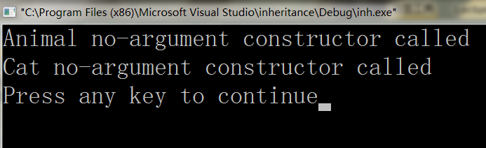
#include<iostream>
using namespace std;
class Animal{
public:
Animal(){cout<<"Animal no-argument constructor called"<<endl;}
};
class Cat:public Animal{
public:
Cat(){cout<<"Cat no-argument constructor called"<<endl;}
};
int main(){
Cat cat;
return 0;
}

Slide 53
#include<iostream>
using namespace std;
class Animal{
private:
int id;
public:
Animal():id(0){cout<<"Animal no-argument constructor called"<<endl;}
Animal(int aid):id(aid){cout<<"Animal parameterized constructor called"<<endl;}
~Animal(){cout<<"Animal destructor is called"<<endl;}
void info(){cout <<"ID:"<< id <<endl;}};
class Cat:public Animal{
public:
Cat(int aid):Animal(aid){cout<<"Cat parameterized constructor called"<<endl;}
Cat(){cout<<"Cat no-argument constructor called"<<endl;}
~Cat(){cout<<"Cat destructor is called"<<endl;}
};
class Tiger: public Cat{
public:
Tiger() {cout<<"Tiger no-argument constructor called"<<endl;}
~Tiger(){cout<<"Tiger destructor is called"<<endl;} };
int main(){
return 0;}
Tiger tiger;
tiger.info();
:Cat(999)

Slide 54
Function Template
#include <iostream>
using namespace std;
template< typename T>
T Div(T a, T b){
if(b==0)
throw b;
return a/b;
}
int main(){
try{
cout<<"5/2="<<Div(5,2)<<endl;
cout<<"6.0/0.0"<<Div(6.0,0.0)<<endl;
cout<<"1.0f/2.0f"<<Div(1.0f,2.0f)<<endl;
}
catch( double ){
cout<<"Error1: /0.0 "<<endl;
}
catch(int){
cout<<"Error2: /0 "<<endl;
}
catch(...){
cout<<"Error3 "<<endl;
}
return 0;
}
Output: 5/2=2
Error1:/0.0

Slide 55
Class Template
template<class T>
class Test{
private:
T n;
const T i;
static int cnt;
public:
Test():i(0){}
Test(T k);
~Test(){}
void print();
T operator+(T x);
};
template<class T>
void Test<T>::print(){
std::cout<<"n="<<n<<std::endl;
std::cout<<"i="<<i<<std::endl;
std::cout<<"cnt="<<cnt<<std::endl;
}
template<class T>
Test<T>::Test(T k):i(k){n=k;cnt++;}
template<class T>
T Test<T>::operator+(T x){return n + x; }
template<class T>
int Test<T>::cnt=0;
The declaration and the definition should in the same file!
Notes:
编译器使用模板，通过更换模板参数来创建数据类型。这个过程就是模板实例化(Instantiation)。
从模板类创建得到的类型称之为特例(specialization)。
模板实例化取决于编译器能够找到可用代码来创建特例(称之为实例化要素，
point of instantiation)。
要创建特例，编译器不但要看到模板的声明，还要看到模板的定义。
模板实例化过程是迟钝的，即只能用函数的定义来实现实例化。

Slide 56
Exception
double area(double radius){ // 圆面积函数
if (radius<=0) throw radius;
return 3.14*radius*radius; }
double volume(double radius,double height){ // 圆柱体积函数
double v = area(radius)*height;
return v; }
void main(){ // 主函数
double radius=0; double height=0;
cout<<"请输入圆柱的底面半径和高："<<endl;
cin>>radius>>height;
try{ cout<<"该圆柱的体积是"<<volume(radius,height)<<endl;
}catch(double radius){
cout<<"输入半径有误 radius="<<radius<<endl;
} }
大连理工大学软件学院

Slide 57
Exception
double area(double radius) throw(double) { // 圆面积函数
try{ if (radius<=0) throw radius;
return 3.14*radius*radius;
}catch(double radius){
cout<<"area函数抛出异常，半径="<<radius<<endl;
throw; // 异常重新抛出
} }
double volume(double radius,double height)throw(double){// 圆柱体积
try{ double v = area(radius)*height;
return v;
}catch(double radius){
cout<<"volume函数抛出异常，半径="<<radius<<endl;
throw; //异常重新抛出
} }
大连理工大学软件学院

Slide 58
Cout
#include <iostream>
using namespace std;
int hello1(){
cout<<"hello1"<<endl;
return 1;
}
int hello2() {
cout<<"hello2"<<endl;
return 2;
}
int main()
{
int a, b;
cout<<"a="<<hello1()<<" b="<<hello2()<<endl;
return 0;
}
cout流的操作顺序是：先从右往左读入缓冲区，然后再从左往右输出。所以它从右边往左读的时候，碰到了函数当然去执行函数先了，然后把函数返回值读入缓冲区再然后。。。就是从左输出了。
hello2
hello1
a=1 b=2

Slide 59
Cout
#include <iostream>
using namespace std;
int main()
{
int b[2]={1,2};
int *a=b;
cout<<*a<<" "<<*(a++)<<endl;
return 0;
}
先读入*（a++），对于a++，是先读入缓冲区，其自增，所以，此时缓冲区中的a是1,再读入*a，此时a已自增，所以读入缓冲区的是2.
output：2 1
#include <iostream>
using namespace std;
int main()
{
int i=5;
cout<<i<<" "<<(i++)<<" "<<(++i)<<endl;
return 0;
}
output：7 6 6

Slide 60
Any other?
Questions?

